Slide 1
Analyzing the Prudential Data Set
Richard Soohoo
1/11/2016

Slide 2
Goals
Want to analyze data from the given data set from the Kaggle competition
Link to page- https://www.kaggle.com/c/prudential-life-insurance-assessment
Two main sets- the test and train set
Third set is the submission for submitting to Kaggle for scoring metrics

Slide 3
From the Kaggle site – Part 1
The response variable has 8 possible ratings. Each application is characterized by a tuple (ea,eb), which corresponds to its scores by Rater A (actual risk) and Rater B (predicted risk). The quadratic weighted kappa is calculated as follows.
First, an N x N histogram matrix O is constructed, such that Oi,j corresponds to the number of applications that received a rating i by A and a rating j by B. An N-by-N matrix of weights, w, is calculated based on the difference between raters' scores:
wi,j=(i−j)2(N−1)2
We want to calculate the response rating and graph those as a predictor of likelihood of users purchasing insurance. Metrics include employment status,health, etc

Slide 4
Initial coding with the pandas
# Imports- Using SK LEARN to initialize data sets
# pandas
import pandas as pd
from pandas import Series,DataFrame
# numpy, matplotlib, seaborn for calculations
import numpy as np
import matplotlib.pyplot as plt
import seaborn as sns
sns.set_style('whitegrid')
%matplotlib inline
# machine learning as we have to use multiple regression sets to classify multiple columns of data
from sklearn.linear_model import LogisticRegression
from sklearn.svm import SVC, LinearSVC
from sklearn.ensemble import RandomForestClassifier
from sklearn.neighbors import KNeighborsClassifier
from sklearn.naive_bayes import GaussianNB
from sklearn import cross_validation

Slide 5
Code for the graph below
# answer response variable on test set
fig, (axis1) = plt.subplots(1,1,figsize=(15,5))
sns.countplot(x=traincsv["Response"], order=[1,2,3,4,5,6,7,8], ax=axis1)

Slide 6
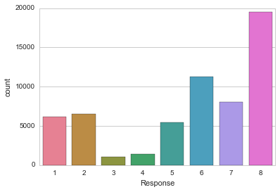
Response plot output

Slide 7
Progress and what next steps
Call out data with the pandas csv read and got the data
Train and test set data and split data to clean out more data
Have to research binary and quadratic kappa for scoring metrics
Add more comments to the code since I have two separate ipython files for the project

